Slide 1
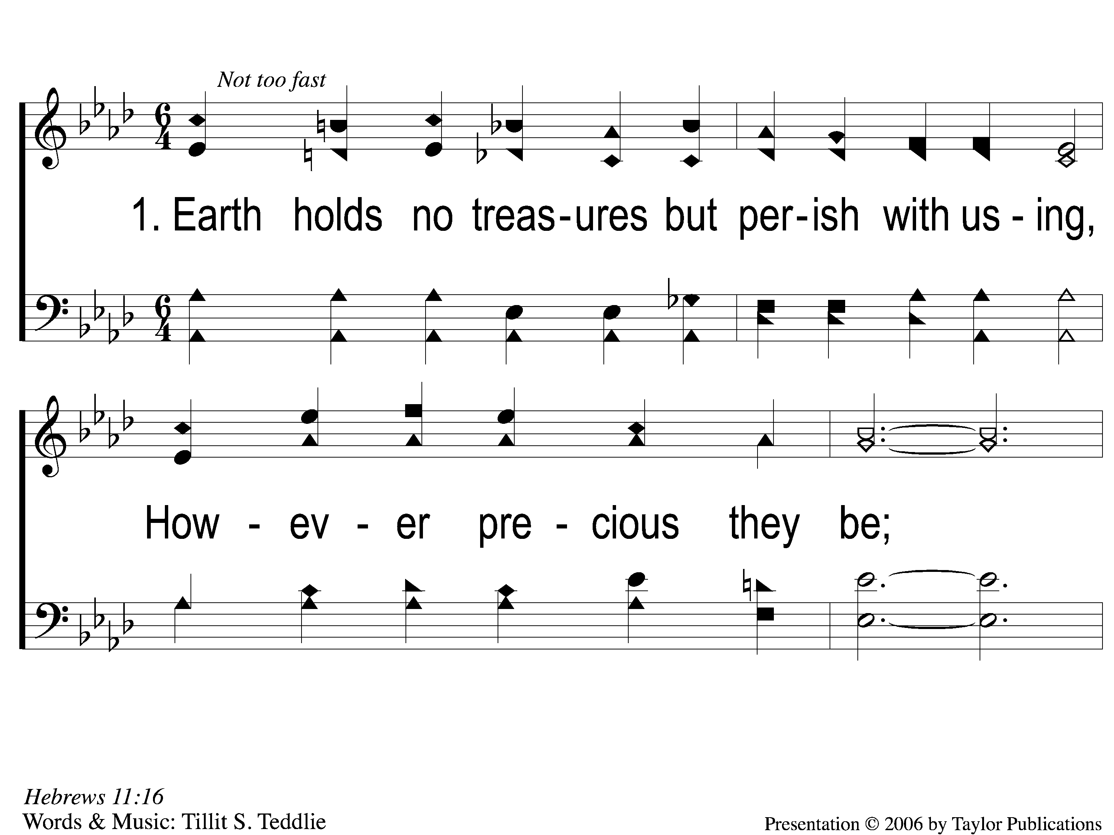
1-1 Earth Holds no Treasures
Earth Holds No Treasures
95

Slide 2
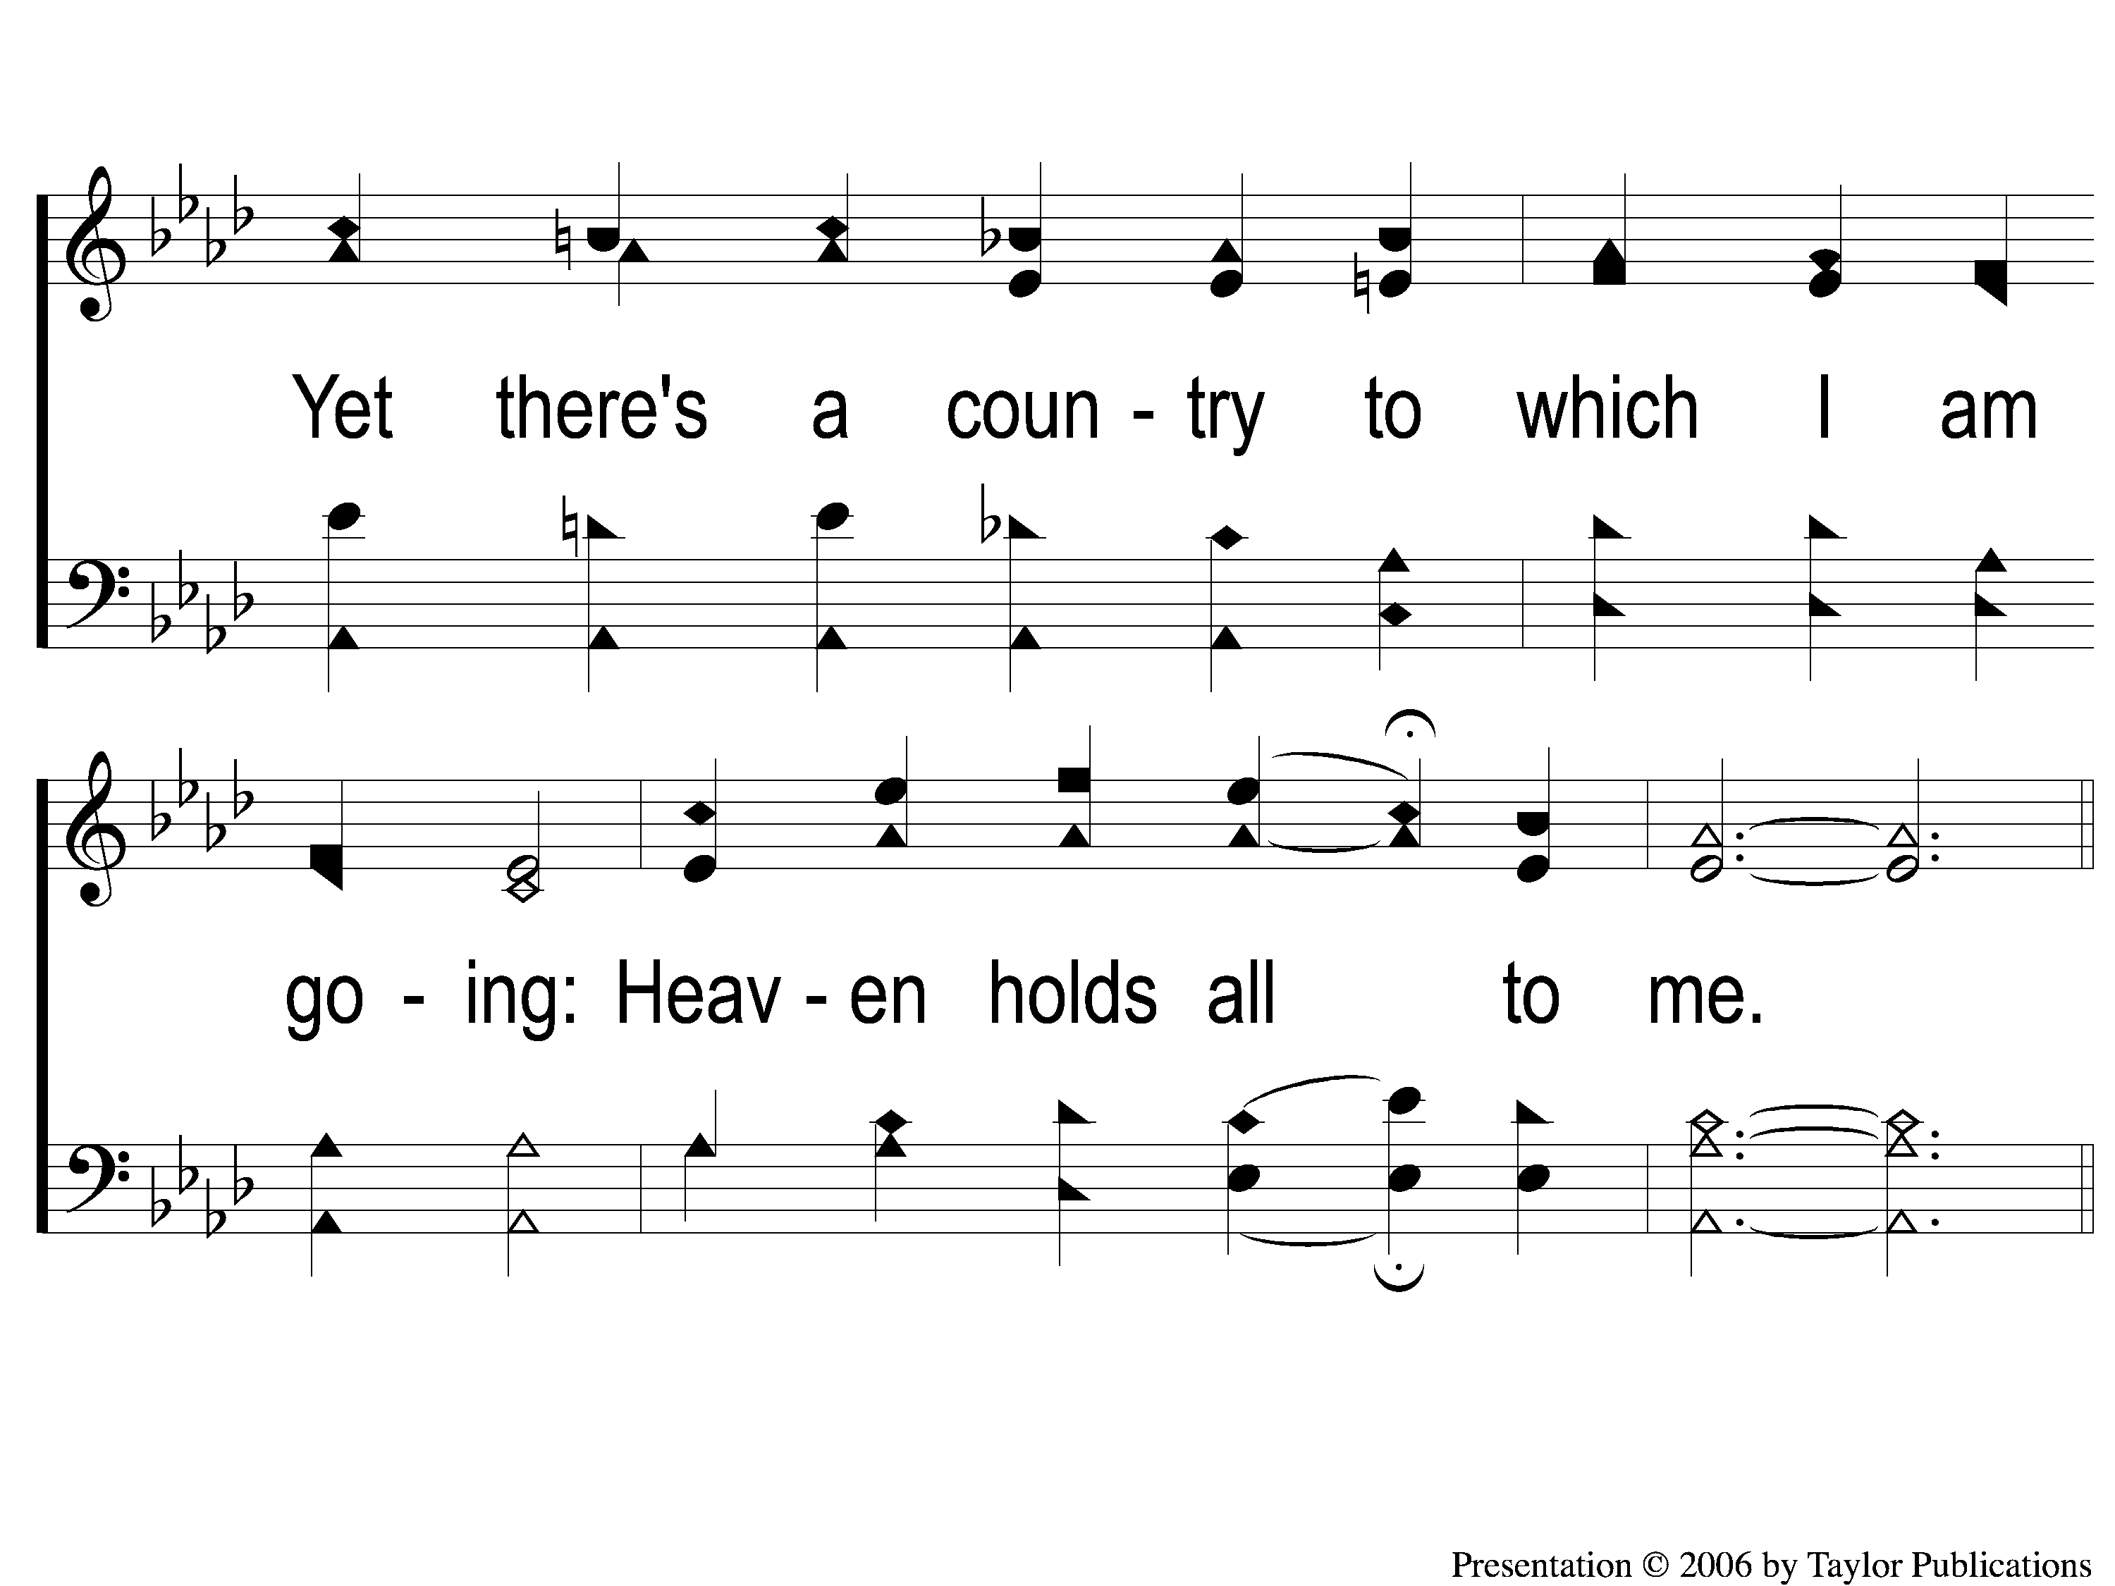
1-2 Earth Holds no Treasures
Earth Holds No Treasures
95

Slide 3
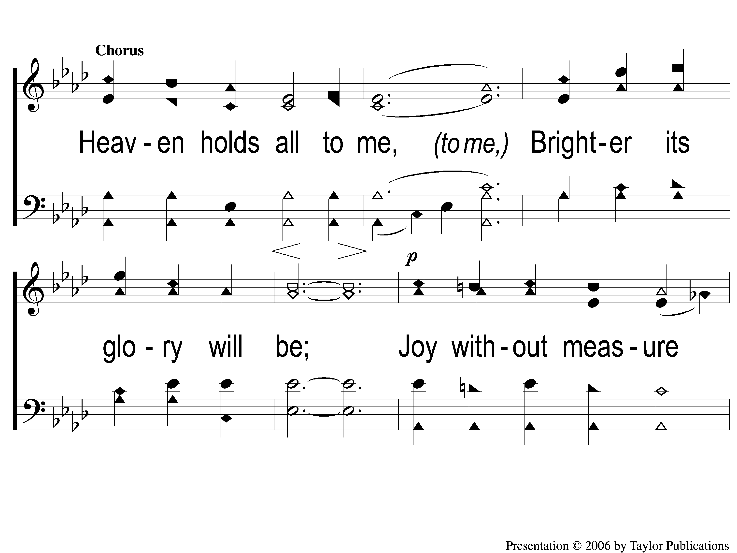
C-1 Earth Holds no Treasures
Earth Holds No Treasures
95

Slide 4
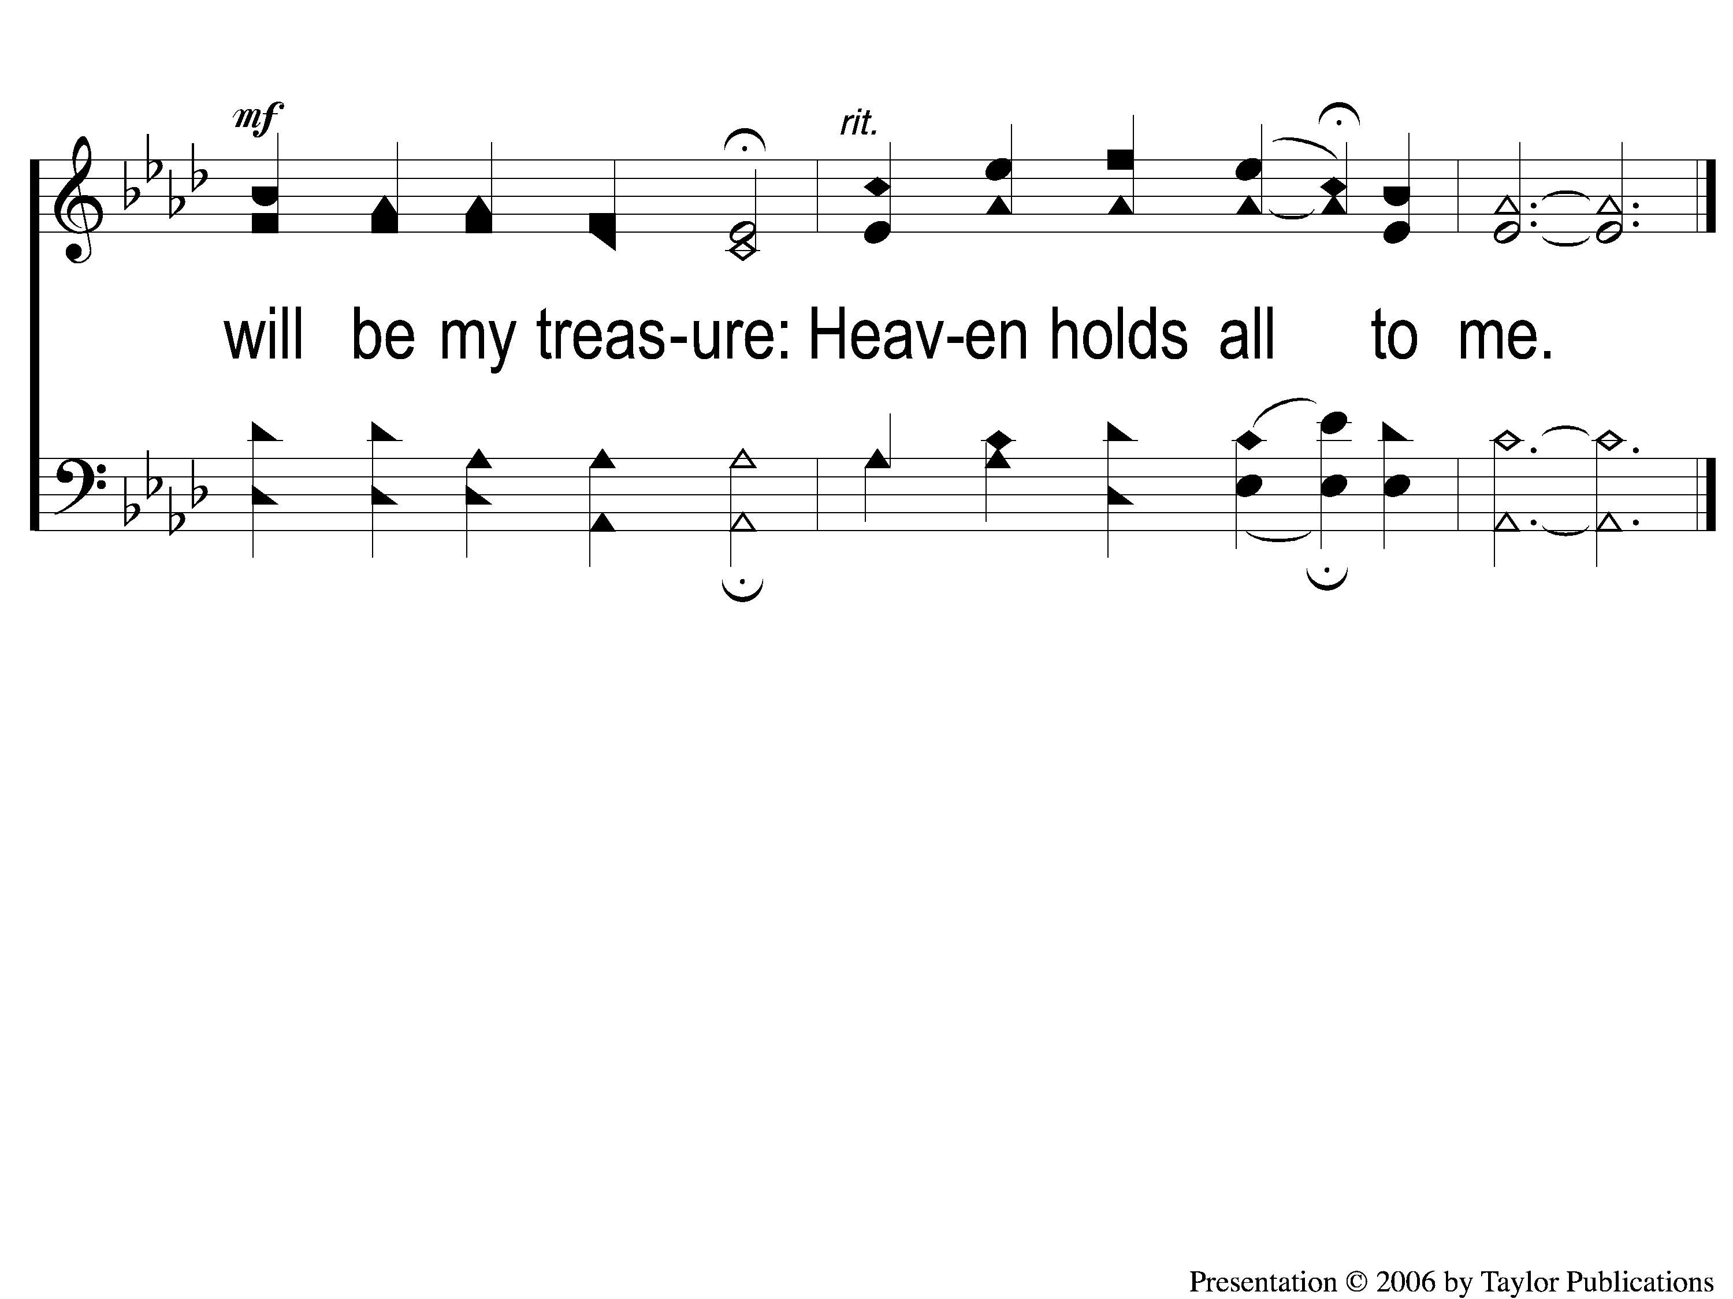
C-2 Earth Holds no Treasures
Earth Holds No Treasures
95

Slide 5
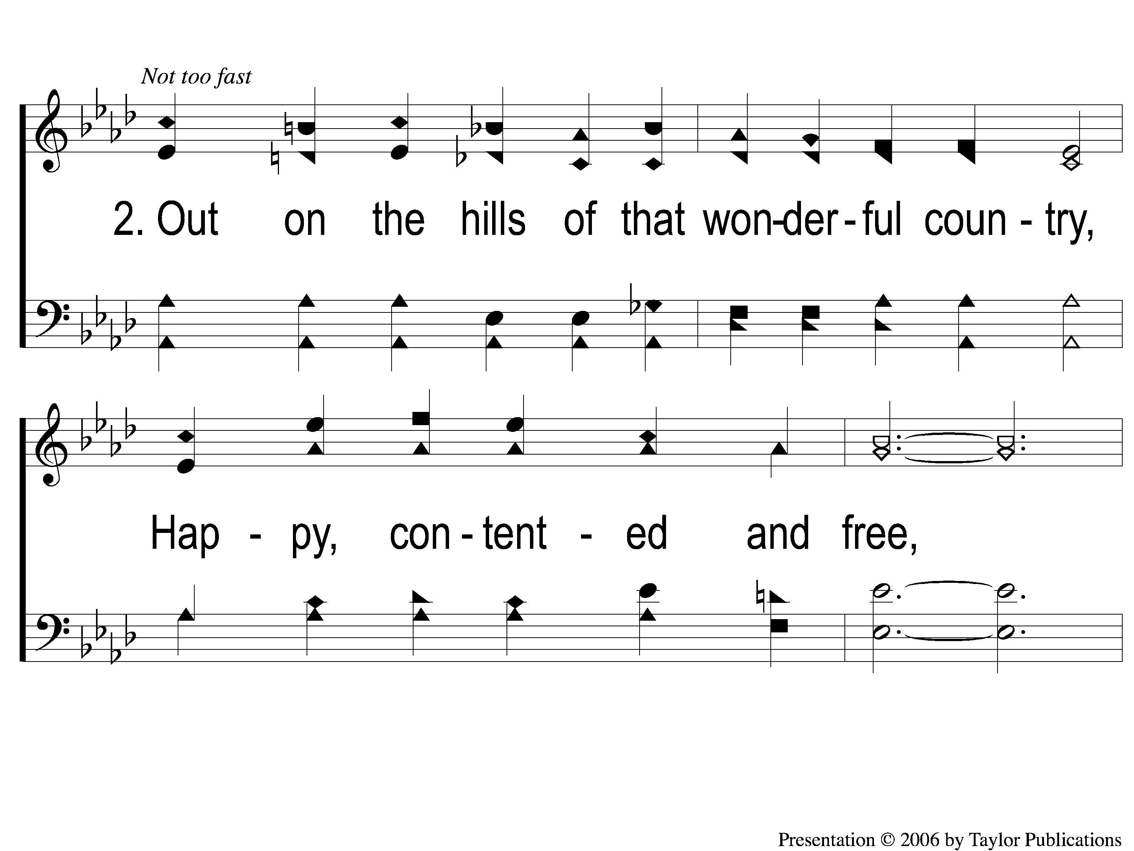
2-1 Earth Holds no Treasures
Earth Holds No Treasures
95

Slide 6
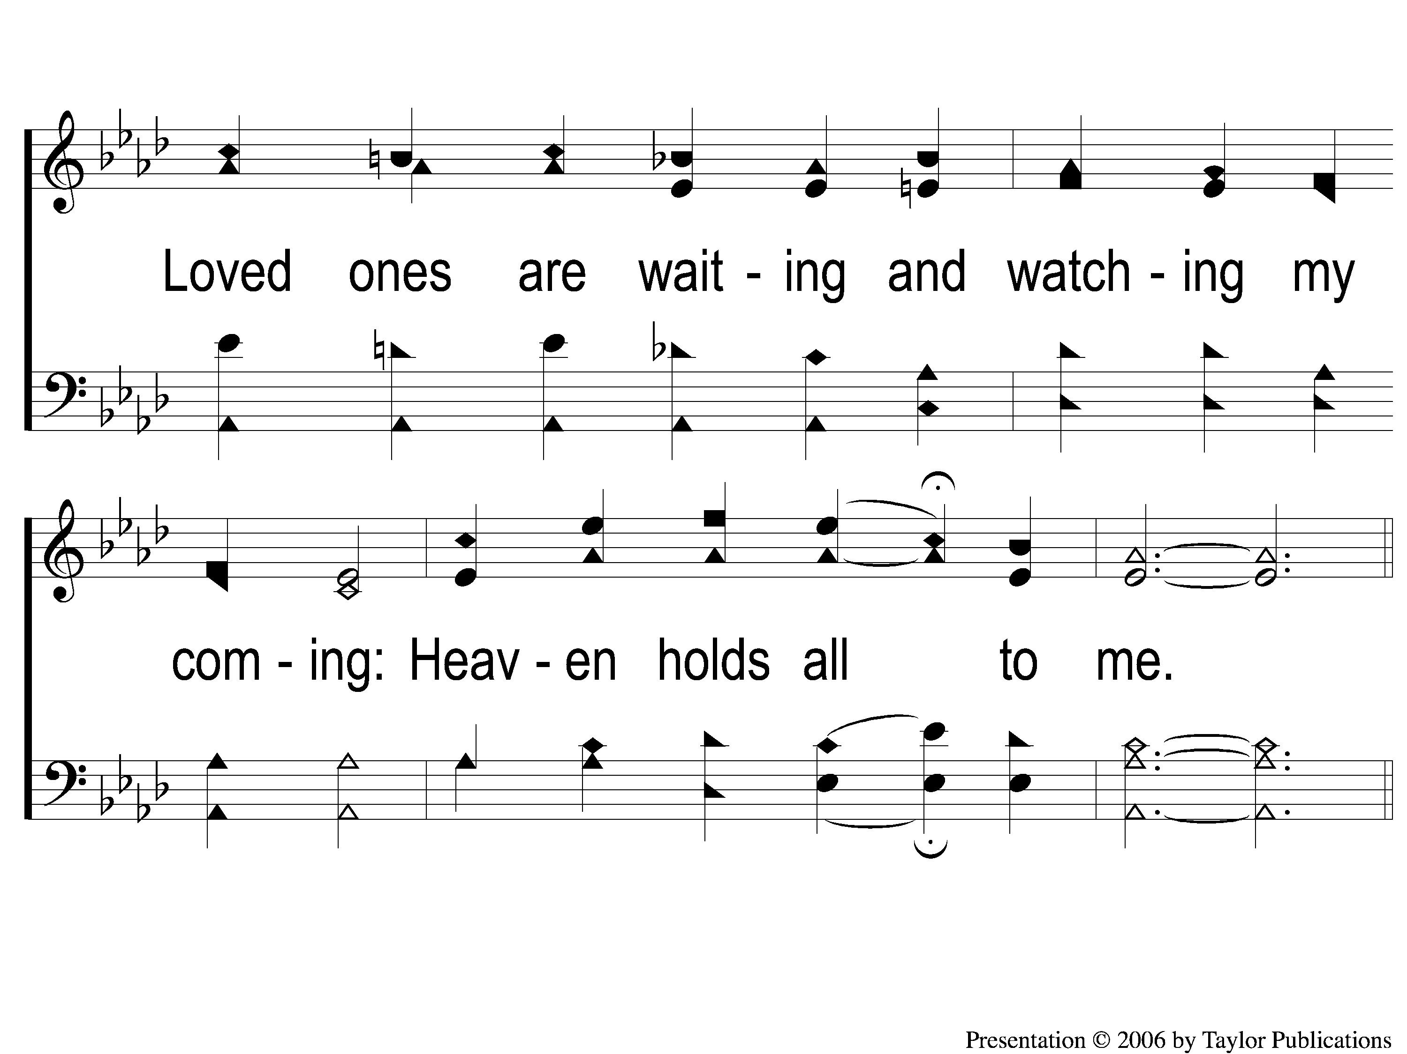
2-2 Earth Holds no Treasures
Earth Holds No Treasures
95

Slide 7
C-1 Earth Holds no Treasures
Earth Holds No Treasures
95

Slide 8
C-2 Earth Holds no Treasures
Earth Holds No Treasures
95

Slide 9
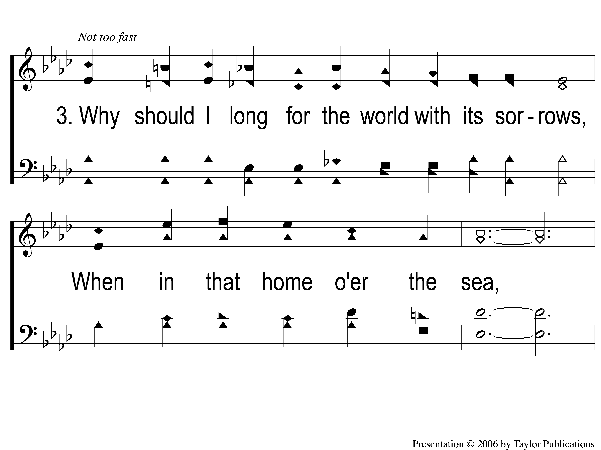
3-1 Earth Holds no Treasures
Earth Holds No Treasures
95

Slide 10
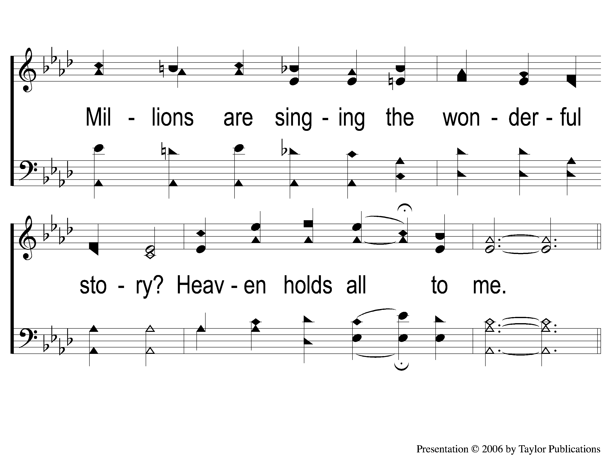
3-2 Earth Holds no Treasures
Earth Holds No Treasures
95

Slide 11
C-1 Earth Holds no Treasures
Earth Holds No Treasures
95

Slide 12
C-2 Earth Holds no Treasures
Earth Holds No Treasures
95

